Slide 1
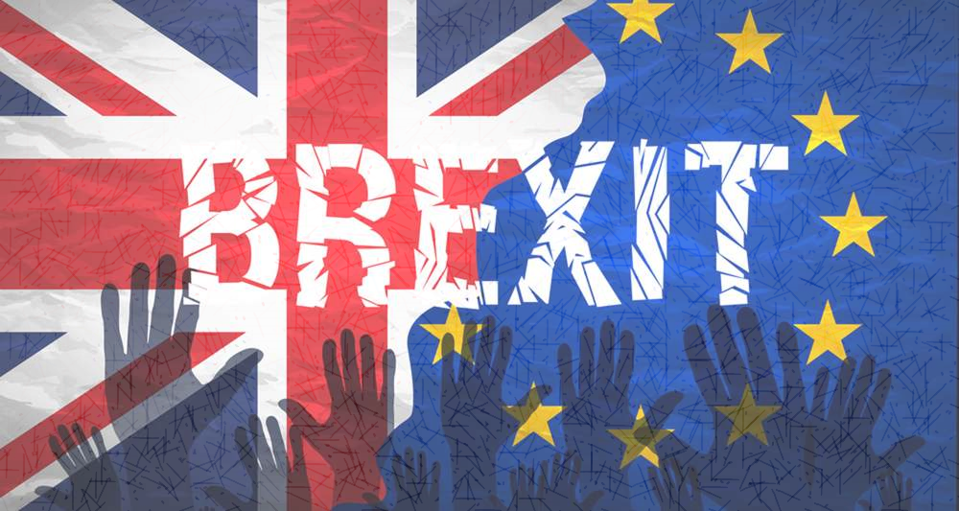
Do the negative economic impacts of Brexit outweigh the positives economic impacts?

Slide 2
Introduction
On Thursday June 24 2016, an election was held in Britain. More than 30 million people in the referendum voted for whether if Britain should stay or remain in the EU. The majority of the British voted to leave the EU and won with 51.9% of the votes.
After Brexit, some economists predicted a major downfall on Britain’s longer term prospects ,some predicted otherwise while some remained neutral.
Many people don’t appreciate that we do not need a trade deal to trade with countries. We do not have a trade deal now with China, the USA, or vast chunks of the world with which we trade. With Brexit we could still trade freely with the EU.
-Gerard Lyons
‘Once inflation rises and real wage growth slows considerably, the key driver of growth in the UK economy will be highly constrained.’
- Noble Francis

Slide 3
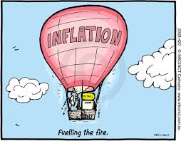
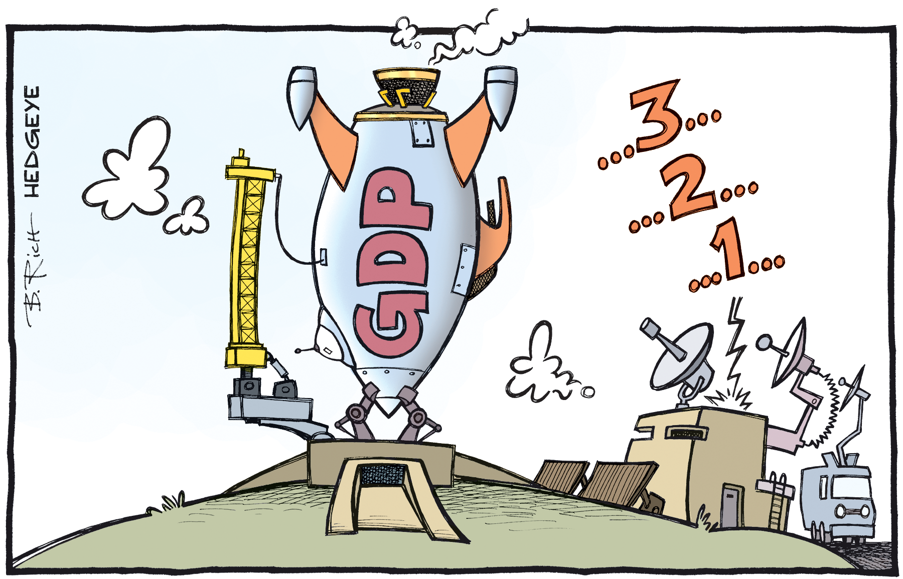
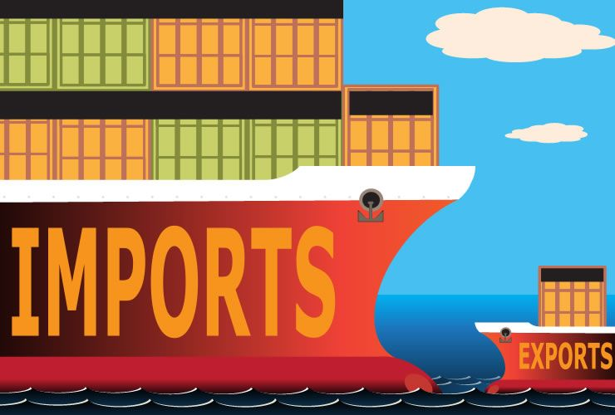
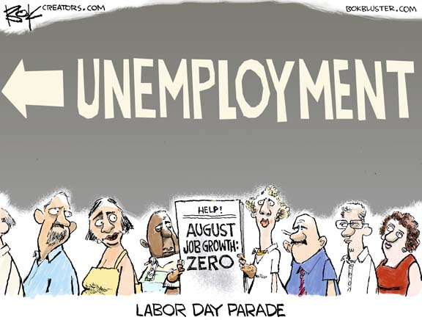
Due to numerous factors, I strongly believe that the negative economic impacts of Brexit outweigh the positive effects. The arguments towards my stance will be listed below according to the 4 main macroeconomic objectives:
Economic growth
Rate of inflation
Unemployment rate
Current account

Slide 4
1) ECONOMIC GROWTH
Short term impacts:
As this event occurred all of a sudden, it will result in a temporary negative shock towards U.K.’s consumers and producers:
Producer uncertainty increases. As businesses are not able to predict consumers’ demands, local firms will deter their investment in the market. Moreover, as the U.K. is not a part of the European Union(E.U.) anymore, it will be unattractive and disadvantageous for European firms to provide inward investment towards the U.K. without free trade. As a result, Britain will not receive revenue from the declined investment.
Rise in prices of imports while fall in prices of exports for the U.K.. Due to the fall in value of pounds, the prices of imports towards the British rise. Therefore, without free trade, local British firms will pay a higher price when importing raw materials for production from members of the EU. For example, British firms will face a higher price when importing car engines from Germany to produce cars for the U.K consumers.

Slide 5
UK’s 15 top trading partners in 2016
United States: US$60.4 billion (14.8% of total UK exports)
Germany: $43.6 billion (10.7%)
France: $25.9 billion (6.3%)
Netherlands: $25.6 billion (6.3%)
Ireland: $22.9 billion (5.6%)
Switzerland: $18.9 billion (4.6%)
China: $18 billion (4.4%)
Belgium: $15.8 billion (3.9%)
Italy: $13.1 billion (3.2%)
Spain: $12.7 billion (3.1%)
United Arab Emirates: $9 billion (2.2%)
Hong Kong: $8.8 billion (2.2%)
Japan: $6.4 billion (1.6%)
Canada: $6.2 billion (1.5%)
Sweden: $6.1 billion (1.5%)
One month before Brexit, the value of one British pound was equal to $1.46 US dollars. After the 24th of May, the value of British pounds fluctuated. However, it dropped dramatically from $1.47 to$1.37 on 25th June right after Brexit was announced. The value of British pounds hit a 31 year low.
As stated above, the 2nd to 6th top trading partners of the U.K. are all members of the European Union. Without the free trade regulations, British suppliers would suffer when purchasing imports from members of the EU. As a result, spending will be reduced and consumers’ demands will not be met.

Slide 6
A slow down in U.K’s Gdp growth rate
According to the diagram, in the longer term after Brexit in July 2016, the GDP growth rate has fallen from 0.7 in the end of 2016 to 0.2 in the beginning of 2017. In July 2017, the GDP growth rate has slight risen from 0.2 to 0.3. However, the 0.3 GDP growth rate was still relatively low compared to other months (e,g, jan 2016:0.7), before Brexit. Even though the GDP growth rate has not become negative yet, the slow down in its GDP growth rate shows a slow down in economic growth caused by Brexit. Therefore, economic growth in the U.K. will slow down for both shorter and longer terms.

Slide 7
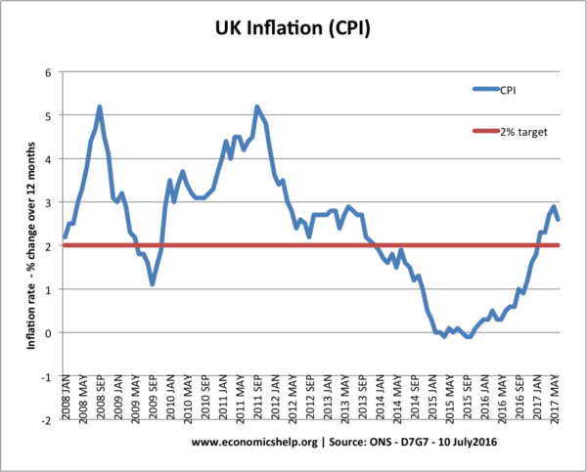
2) Rate of inflation
As mentioned above, as the value of British pounds have fallen, the rate of inflation increases. When prices of exports reduce, the U.K. firms become more competitive, which increase the aggregate demand of the U.K. As a result, the prices of goods are pushed up.
The effect of the depreciation of British pounds caused by Brexit has only been shown on the inflation rate in May 2017 roughly 1 year after Brexit. According to the Consumer Price Index(CPI), the inflation rate in the U.K. reached 2.9% in May 2017, which was a 4 year high, and way above the 2% inflation rate target. Food, energy, recreational goods( games and toys) were all major contributors to the boost in inflation rate in May as they are all imports.

Slide 8
Effects of higher inflation rate
Redistribution of income. Due to the high inflation rate, borrowers will benefit while savers suffer. As the value of pounds have depreciated, the rate of inflation becomes higher than the interest rates. Therefore, the value of money ( purchasing power) of the loan repayment of borrowers will be reduced. On the other hand, the loan repayment received by the savers will decrease in value.
Widening of income gaps. As prices of goods rise, It will become less affordable for lower income families. This will accentuate the inequality between low and high income groups, as the families with higher incomes will not be as bothered about the increased prices as the lower income groups.
Shoe leather costs. People in the UK will spend more time searching for products that are affordable and have the best value of money. This incurs transaction costs.

Slide 9
3) Unemployment rate
Theoretically, after Brexit, the U.K. will face a higher unemployment rate:
Due to a lack of consumer confidence after Brexit, it was reported that the consumer spending growth in the U.K. has slowed down sharply. Therefore, the labour demand in the U.K. will be lowered as it is derived by the lowered aggregate demand for the final products.
Moreover, as the incentives for innovation has lowered due to the slump in business confidence as well, products become less interesting and unattractive to consumers, leading to a lower aggregate demand
Furthermore, as the EU have strict regulations for the movement of labour with non members, the rate of migration of workers into and out of the country will lower, due to the lack of free movement of labour within the EU. This means that labour in the UK will not be interchanged freely in one single market. As a result, low skilled jobs that are often made up of migrant labour will be in shortage. For examples, low skilled labour filling low wage sectors such as agriculture, plumbing will be restricted by the stricter regulations in the EU, so the labour market in the U.K becomes less flexible. On the other hand, workers in the UK will not be able to move to other countries in the EU for work as easily as well. This increases the overall unemployment rate in the UK.

Slide 10
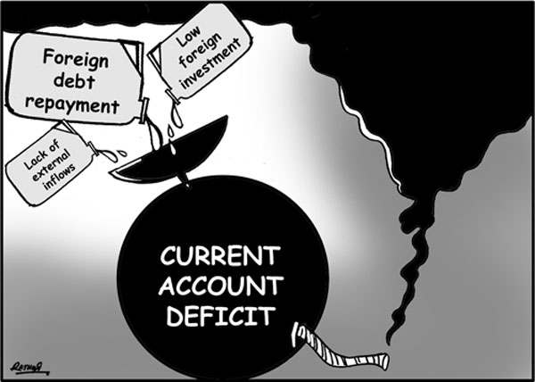
4) Current account
As according to the graph, the current account deficit in the U.K. has been gradually increasing since Q4 of 2004 to Q3 of 2016, which is right after Brexit. The current account deficit reached higher than 5% of GDP in 2016. This shows that due to deterred inward investments from foreign firms, the money inflow for the U.K. has decreased, widening the gap between the the money inflow and outflow for the U.K, which widens the current account deficit.

Slide 11
However……
Although the negative impacts of Brexit outweigh the positive impacts, there are a few advantages to the economy…….
As the value of pounds weaken, U.K’s exports become more competitive as their prices lower. As a result, the demand for exports increase, which boosts U.K’s aggregate demand and economic growth. However, according to statistics listed previously, as shown by the highest rate of inflation in the UK since 2013, the weakening of pounds also raises the rate of inflation, and the negative impacts caused by the rate of inflation outweighs the positives.
Also, gas and coal-fired power stations produce about half of the UK's electricity. Due to strict EU regulations, coal-fired plants are being phased out to meet clean air rules set by the EU , which might solve UK’s environmental problems and help combat climate change. However, in the economics perspective, as coal is a relatively cheaper source of energy, phasing out coal and choosing for more expensive alternatives will add economic burden to a lot of households.

Slide 12
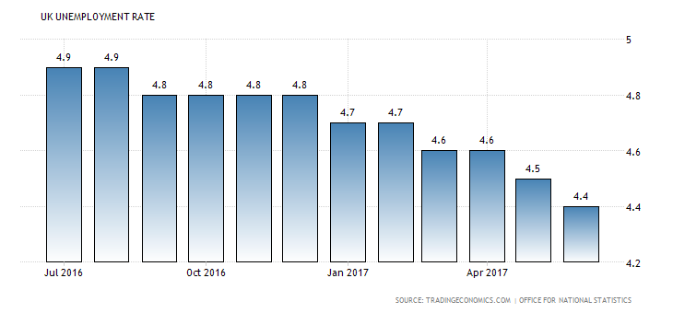
EVALUATION
The magnitude of the negative economic effects caused by Brexit depends on the time period after Brexit. In the short term, as Brexit created a negative shock towards the economy. Consumers and producers’ confidences drop, value of pounds drop etc, causing significant problems such as increasing current account deficit and a slower economic growth. However, in the longer term, a few years after Brexit, the U.K. economy will slowly adapt to the changes and will be able to develop a more powerful economy independent from the EU.
Moreover, according to the most recent statistics, the unemployment rate in the U.K has reached a 42-year low of 4.4%, which shows the negative expectations towards the unemployment rate has showed quite an opposite result:

Slide 13
Conclusion
In conclusion, as the U.K. citizens have decided to leave the E.U., in the short term, there were various negative economic consequences: weakening of the British pounds causing an inflation, a larger current account deficit, a fall in GDP causing a slow economic growth etc. Even though the size of impacts depend on the time period after Brexit and positive impacts are still created, the number of negative impacts caused by Brexit definitely outweighs the positive economic effects.

Slide 14
references
https://woodfordfunds.com/economic-impact-brexit-report/
https://www.theguardian.com/business/ng-interactive/2017/apr/25/how-has-the-brexit-vote-affected-the-uk-economy-april-verdict
http://www.economicshelp.org/blog/16766/euro/economics-effects-of-the-uk-leaving-the-european-union/
https://www.lse.ac.uk/europeanInstitute/LSE-Commission/Hearing-11---The-impact-of-Brexit-on-jobs-and-economic-growth-sumary.pdf http://www.bbc.com/news/uk-politics-32810887
https://www.thesun.co.uk/news/politics/2077969/top-economist-gerard-lyons-says-brexit-will-save-us-12-billion-as-quitting-eu-slashes-red-tape/
https://www.cnbc.com/2017/03/07/uk-consumer-spending-hits-5-year-low-ahead-of-brexit-budget.htm
https://www.theguardian.com/business/2017/may/25/uk-gdp-growth-inflation-ons-prices-brexit

